Slide 1
Outline of Today’s Discussion
Displaying the Order in a Group of Numbers:
The Mean, Variance, Standard Deviation, & Z-Scores
SPSS: Data Entry, Definition, & Frequency Analysis

Slide 2
Part 1
Displaying the Order
In a Group of Numbers:

Slide 3
Two Branches of Statistical Methods
Descriptive statistics
Summarize and describe a group of numbers such as the results of a research study
Inferential statistics
Allow researchers to draw conclusions and inferences that are based on the numbers from a research study, but go beyond these numbers

Slide 4
Basic concepts
Variables
Characteristics that can take on any number of different values
Values (think of this as ‘levels’)
Possible numbers or categories that of a variable can have
Scores
A particular person’s value on a variable

Slide 5
Kinds of Variables
Numeric variables
Scores are numbers that tell you how much there is of the thing being measured
Equal-interval variables
Values are numbers that stand for equal amounts of what is being measured
e.g., a height of 6 feet, an IQ of 138
Rank-order variables
Values are ranks
e.g., 2nd in the Olympic ski jump, 6th in your graduating class

Slide 6
Kinds of Variables
Nominal variables
Values are categories
e.g., Hair color of brown, American citizenship

Slide 7
Frequency Tables
Frequency table
Shows how many times each value was used for a particular variable
Percentage of scores of each value
Grouped frequency table
Range of scores in each of several equally sized intervals

Slide 8
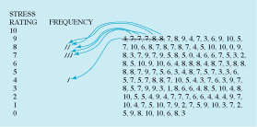
Steps for Making a Frequency Table
1. Make a list of each possible value, from highest to lowest
2. Go one by one through the scores, making a mark for each score next to its value on the list
3. Make a table showing how many times each value on your list was used
4. Figure the percentage of scores for each value

Slide 9
A Frequency Table
Travel Time | Frequency | Percent
10 | 14 | 9.3
9 | 15 | 9.9
8 | 26 | 17.2
7 | 31 | 20.5
6 | 13 | 8.6
5 | 18 | 11.9
4 | 16 | 10.6
3 | 12 | 7.9
2 | 3 | 2.0
1 | 1 | 0.7
0 | 2 | 1.3

Slide 10
A Grouped Frequency Table
Travel Time (min) | Frequency | Percent
0-5 | 14 | 9
8-9 | 41 | 27
6-7 | 44 | 29
4-5 | 34 | 23
2-3 | 15 | 10
0-1 | 3 | 2

Slide 11
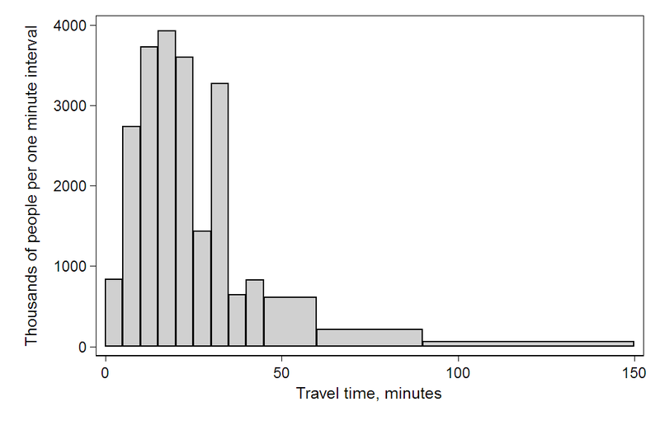
Frequency Graphs
Histogram
Depicts information from a frequency table or a grouped frequency table as a bar graph

Slide 12
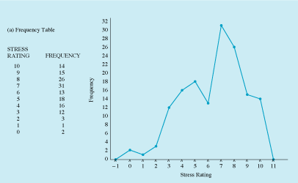
Frequency Graphs
Frequency Polygon
Depicts the same information by plotting a point to show the frequency of each value or range of values
Points are joined with a line

Slide 13
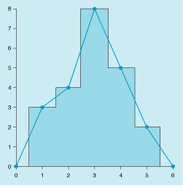
Frequency Graphs
Histogram and frequency polygon for the same data

Slide 14
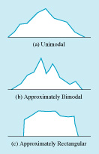
Shapes of Frequency Distributions
Unimodal
Having one peak
Bimodal
Having two peaks
Multimodal
Having two or more peaks
Rectangular
Having no peaks

Slide 15
Symmetrical vs. Skewed Frequency Distributions
Symmetrical distribution
Approximately equal numbers of observations above and below the middle
Skewed distribution
One side is more spread out that the other, like a tail
Direction of the skew
Right or left (i.e., positive or negative)
Side with the fewer scores
Side that looks like a tail

Slide 16
Skewed Frequency Distributions
Skewed right (b)
Fewer scores right of the peak
Positively skewed
Can be caused by a floor effect
Skewed left (c)
Fewer scores left of the peak
Negatively skewed
Can be caused by a ceiling effect

Slide 17
Potential Pop Quiz Item
Using your imagination, identify a phenomenon that would be well described by a positively skewed frequency distribution. Draw the positively skewed distribution, and be sure to label your axes. Then briefly explain why the distribution would be positively skewed.
Repeat the exercise above, but now for a negatively skewed frequency distribution.

Slide 18
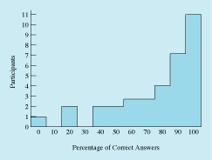
Ceiling and Floor Effects
Ceiling effects
Occur when scores can go no higher than an upper limit and “pile up” at the top
e.g., scores on an easy exam, as shown on the right
Causes negative skew
Floor effects
Occur when scores can go no lower than a lower limit and pile up at the bottom
e.g., household income
Causes positive skew

Slide 19
Kurtosis
Degree to which tails of the distribution are “heavy” or “light”
heavy tails = many scores at the extreme ends (b)
Light tails = few scores at the extreme ends (c)
leptokurtic
platykurtic

Slide 20
Kurtosis
A perfect, normal distribution zero kurtosis irrespective of its mean or standard deviation. It is said to be mesokurtic.
If a random variable’s kurtosis is greater than 0, it is said to be leptokurtic. (peaked, and fat tails i.e., more frequent extreme values than a Gaussian.)
If its kurtosis is less than 0, it is said to be platykurtic. (flat-ish, and thin tails, i.e., less frequent extreme values than a Gaussian)
Can you think of a mnemonic for those terms?

Slide 21
The Normal Curve
Often seen in social and behavioral science research and in nature generally
Also Called “Gaussian” Distribution or Curve
Particular characteristics
Bell-shaped
Unimodal
Symmetrical
Average tails

Slide 22
The Normal Curve
Here’s the equation for the Bell Curve:
Do the equations below look familiar?
Y = mX + B
Y = aX² + bX + c
How many parameters in each equation?

Slide 23
Part 2
The Mean, Variance,
Standard Deviation,
&
Z-Scores
(I LOVE Z-Scores!!!!)

Slide 24
Measures of Central Tendency
Central tendency = representative or typical value in a distribution
Mean
Same thing as an average
Computed by
Summing all the scores (sigma, Σ)
Dividing by the number of scores (N)

Slide 25
Measures of Central Tendency
Mean
Often the best measure of central tendency
Most frequently reported in research articles
Think of the mean as the “balancing point” of the distribution

Slide 26
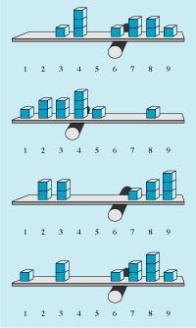
Measures of Central Tendency
Examples of means as balancing points of various distributions
Does not have to be a score exactly at the mean
Note that a score’s distance from the balancing point matters in addition to the number of scores above or below it

Slide 27
Measures of Central Tendency
Mode
Most common single number in a distribution
If distribution is symmetrical and unimodal, the mode = the mean
Typical way of describing central tendency of a nominal variable

Slide 28
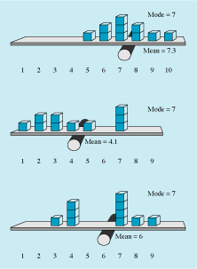
Measures of Central Tendency
Examples of means and modes

Slide 29
Measures of Central Tendency
Median
Middle value in a group of scores
Point at which
half the scores are above
half the scores are below
Unaffected by extremity of individual scores
Unlike the mean
Preferable as a measure of central tendency when a distribution has some extreme scores

Slide 30
Measures of Central Tendency
Steps to computing the median
1. Line up scores from highest to lowest
2. Figure out how many scores to the middle
Add 1 to number of scores
Divide by 2
3. Count up to middle score
If there is 1 middle score, that’s the median
If there are 2 middle scores, median is their average

Slide 31
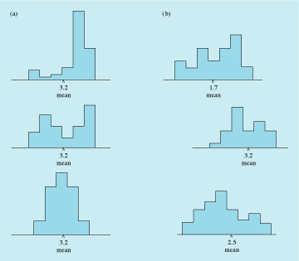
Measures of Variation
Variation = how spread out scores are
Distributions to the right all have same mean but different amounts of spread
Variance
Measure of variation
Average of each score’s squared deviations (differences) from the mean

Slide 32
Measures of Variation
Steps to computing the variance
1. Subtract the mean from each score
2. Square each deviation score
3. Add up the squared deviation scores
4. Divide sum by the number of scores
Thus, variance is the average (steps 3 & 4) of the squared (step 2) deviations from the mean (step 1)

Slide 33
Measures of Variation
Standard deviation
Another measure of variation, roughly the average amount that scores differ from the mean
Used more widely than variance
Abbreviated as “SD”
To compute standard deviation
Compute variance
Simply take the square root
SD is square root of variance
Variance is SD squared

Slide 34
Z Scores
Allow you to describe a particular score in terms of where it fits into the overall group of scores in a distribution
If positive, indicates the number of SDs a score is above the mean of its own distribution
If negative, indicates the number of SDs a score is below the mean of its own distribution
Z score of 1.0 is one SD above the mean
Z score of -2.5 is two-and-a-half SDs below the mean
Z score of 0 is at the mean

Slide 35
Z Scores
When values in a distribution are converted to Z scores, the distribution will have
Mean of 0
Standard deviation of 1
Useful
Allows variables to be compared to one another even when they are measured on different scales, have very different distributions, etc.
Provides a generalized standard of comparison

Slide 36
Z Scores
To compute a Z score, subtract the mean from a raw score and divide by the SD
To convert a Z score back to a raw score, multiply the Z score by the SD and then add the mean

Slide 37
Part 3
SPSS: Data Entry, Definition
&
Frequency Analysis

